Slide 1


Alginate Antacid (Gaviflux) recommended for the first line treatment option of GERD

Slide 2



Slide 3

Raw Material From

Slide 4
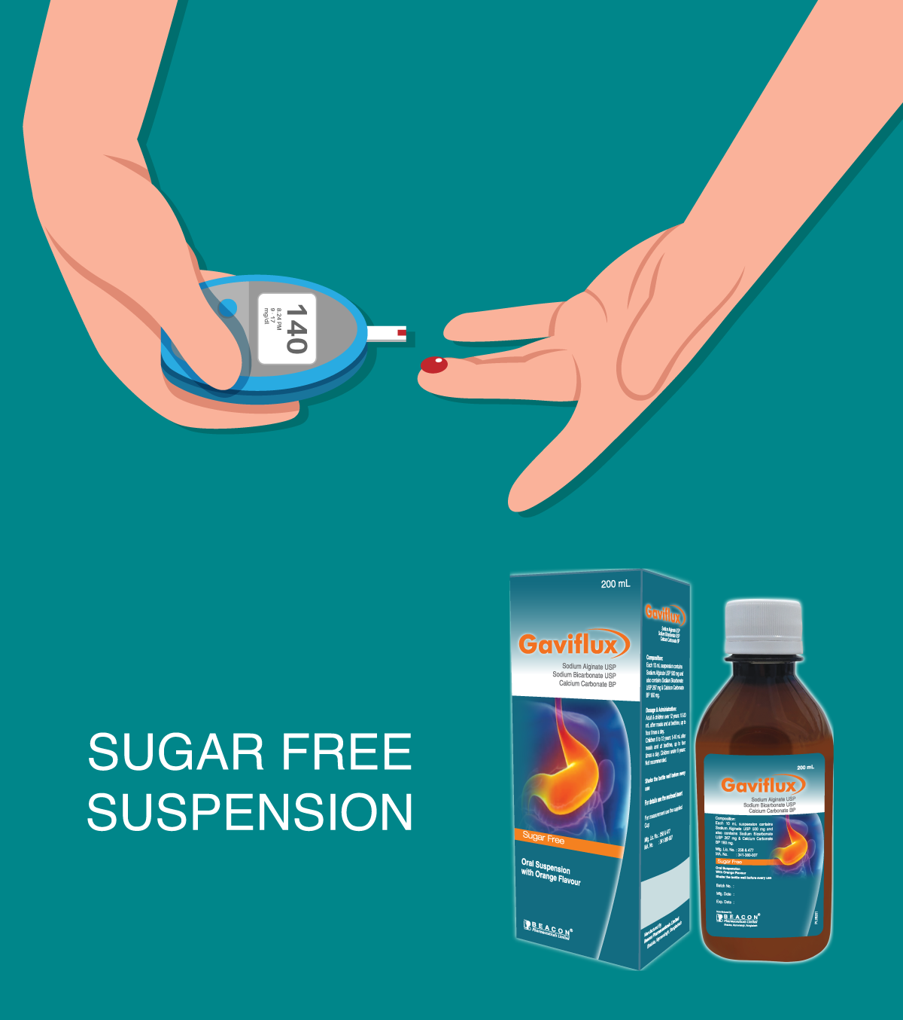

Slide 5


